Slide 1
PURITY TEST OF DISTILLED WATER
Dr.VENUGOPAL K.G
Associate Professor
Dep of Pharmacy

Slide 2
AIM
To determine the impurity present in the given sample of distilled water.

Slide 3
MATERIALS REQUIRED
Sample of distilled water
Silver nitrate solution
Dilute nitric acid
Ammonium oxalate solution
Dilute nitric acid
Ammonium oxalate solution
Dilute hydrochloric acid
Barrium chloride solution
Nesslers reagent
Test tubes
Diluted acetic acid

Slide 4
PROCEDURE
EXPERIMENT | OBSERVATION | REFERENCE
1.TEST FOR CHLORIDE Take few ml of the given sample of distilled water in a test tube and add few drops of Ag.No3 solution and dilute HNO3 | Formation of a white turbidity | Presence of Chloride

Slide 5
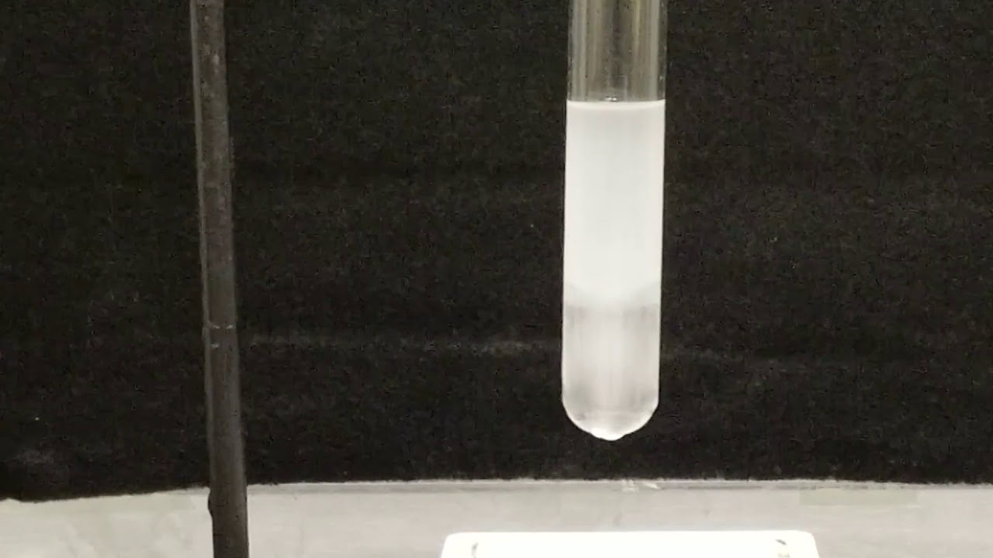
TEST FOR CHLORIDE-White turbidity

Slide 6
TEST FOR CALCIUM
TEST FOR CALCIUM Take few ml of the given sample of distilled water in a test tube and add Ammonium oxlate solution and dilute acetic acid. | A white turbidity obtained | Presence of Calcium

Slide 7
TEST FOR CALCIUM

Slide 8
TEST FOR SULPHATE
EXPERIMENT | OBSERVATION | INFERENCE
The given sample of distilled water given, is taken in a test tube and add few drops Barium chloride and dilute hydrochloric acid | A white turbidity obtained | Presence of Sulphate

Slide 9
Presence of Sulphate-White Turbidity

Slide 10
TEST FOR AMMONIA
EXPERIMENT | OBSERVATION | INFERENCE
To few ml of test solution taken in a test tube add few drops of Nessler s reagent | Formation of brown coloured preciptate | Presence of Ammonia

Slide 11
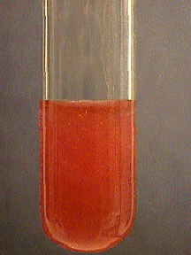
TEST FOR AMMONIA

